Slide 1
Computer Science in Medicine and Industry
An Introduction
Lecture 1
Dr hab. Andrzej Jankowski, professor UWM
5/X//2022

Slide 2
Tentative syllabus for the semester
An introduction to applications of computer science in medicine and industry
Vague concepts processing in a complex open environment is one of the main barriers to developing advanced applications of computer science
Computational models for vague concepts processing in a complex in open environment (rough sets, fuzzy sets, and granular computing)
Introduction to rough sets (approximations of concepts, decision systems, reducts, decision rules, discretization) and development of approximate classifiers.
Design and development of classifiers (simple and hierarchical) using rough sets.
Basics of fuzzy sets and their application to constructing decision systems and process control systems.
Concept of granular computing
Constructions of explainable classifiers using linear and logistic regression, decision trees, random forests, and SVM
Classifiers development for imbalanced data
An introduction to optimization algorithms in IT applications in medicine and industry

Slide 3
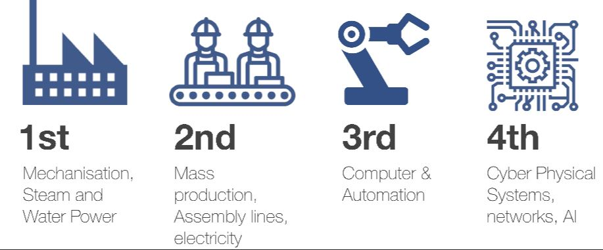
An introduction to applications of computer science in medicine and industry
1700s 1800s 1900s Today

Slide 4
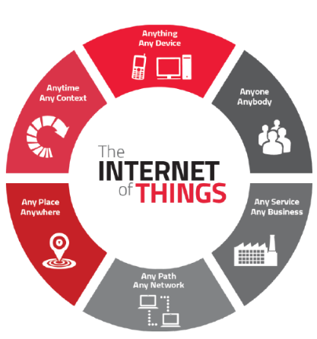
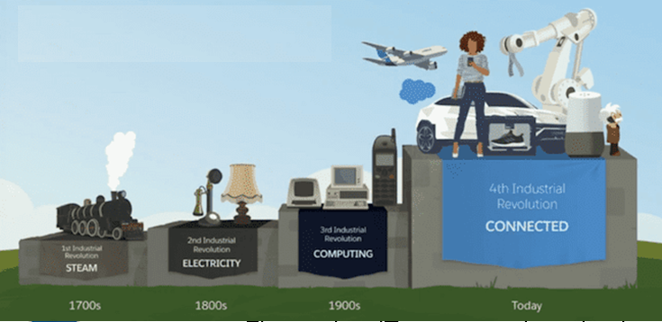
An introduction to applications of computer science in medicine and industry

Slide 5
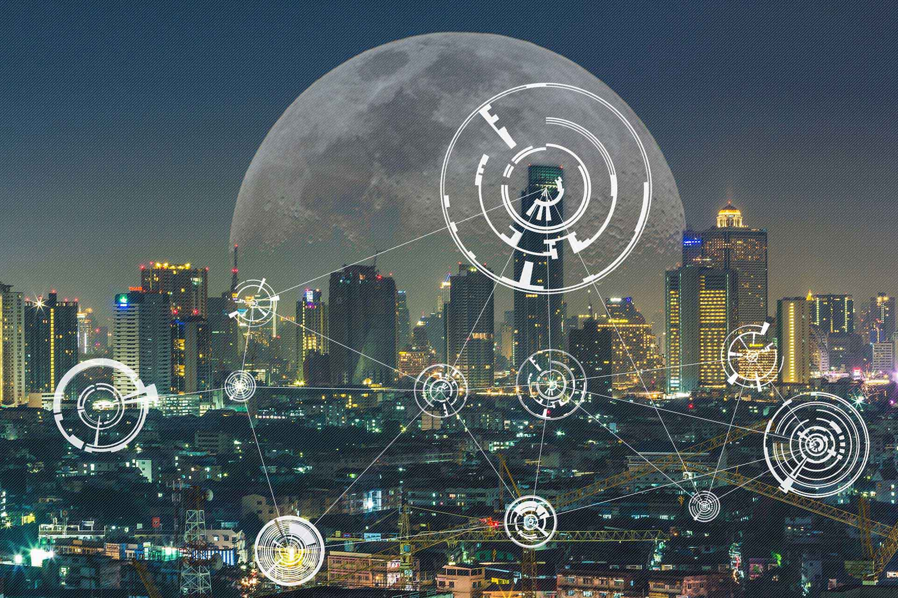
An introduction to applications of computer science in medicine and industry
Internet of Intelligent Things (IIoT)

Slide 6
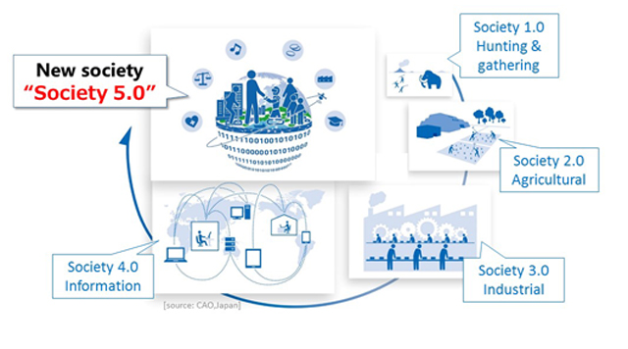
An introduction to applications of computer science in medicine and industry
https://www8.cao.go.jp/cstp/english/society5_0/index.html

Slide 7
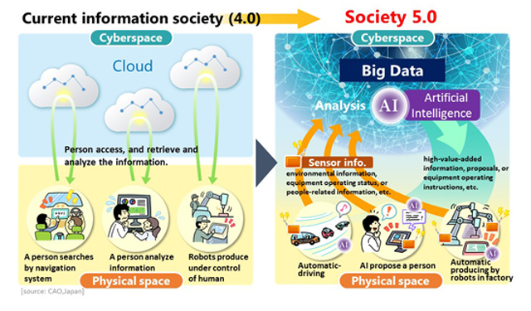
An introduction to applications of computer science in medicine and industry

Slide 8
An introduction to applications of computer science in medicine and industry
1. Medical Imaging & Image Analysis
Medical imaging is a broad term that covers technology used to create images of the human body for study, diagnosis, therapy, guiding advanced surgeries. It includes magnetic resonance imaging (MRI), ultrasound, CT scans and X-Rays. Ali of these devices are controlled by computers. Even X-Ray imaging, which has been used in medicine since the early 2Oth century, now uses computers for image adjustment and transfer.
2. Patient Monitoring & Health Risk identification and Prevention Assessment
Modern computer-based patient monitoring machines allow heart rate, respiratory activity, blood pressure and other critical vitaI signs to be collected automatically in digital form. Computer monitoring machines cut down on the time spent on routine tests in doctors' offices. In hospitals, they can automatically update and assess a patient’s chart and notify hospital staff of change in stoa patient’s vitals.

Slide 9
An introduction to applications of computer science in medicine and industry
3. Computer-Assisted Surgery
Computers are used to assist in planning, teaching and performing many surgical procedures. One of the biggest recent developments in this area is robotically-assisted surgery (RAS), which allows surgeons to use robotic devices and Computer software to complete minimally-invasive procedures. The surgeon remains in control and guides the robot device to complete complex operations in confined parts of the body.
4. Networks and Digital Communication
Computer networks and the internet have increased the means of communication between medical professionals with email, instant messaging, video chats and webinars. Being able to connect digitally helps health care professionals stay current with the latest medical developments. They can also consult with colleagues in real-time and receive second opinions for diagnoses and treatment options.

Slide 10
An introduction to applications of computer science in medicine and industry
5. Telemedicine
The concept of a house visit is returning to health care in the form of telemedicine. Thanks to computers and smartphones, some medical professionals use video chats to visit with patients remotely. Besides benefitting patients who live in rural areas with limited health care options, telemedicine has proved useful following natural disasters and in war zones.
6. Electronic Health Records
One of the most significant developments in health care, the electronic health record (EHR) is also one of the most far-reaching. An EHR is a digital version of a patient's paper chart that is instantly available to authorized health providers.

Slide 11
An introduction to applications of computer science in medicine and industry
7. Medical Databases & NLP
Computers have brought the development of many useful software Solutions in the medical field. Large public health organizations like the World Health Organization and the Centers for Disease Control have amassed huge databases of information related to diseases and health statistics. There are also public databases available with Information about toxic substances, clinical research results and drug coverage.
8. Medical Research & Knowledge Discovery
Much of the current research being done into incurable diseases like AIDS and cancer involves the creation of complex Computer simulations. Supercomputers and distributed Computer systems can to handle massive amounts of research data and analyze millions of possible outcomes. The mapping of the human genome is one example of how computers are advancing medical research.

Slide 12
An introduction to applications of computer science in medicine and industry
9. Computers and Hospital Administration
Most hospitals depend heavily on computers and specialized software that handles patient records, supply inventory, personnel scheduling and all the other details required to care for patients. The use of a Computer in a hospital extends to every department, from the surgical center to the cafeteria. Larger hospitals may have their own private Computer servers and network and a team of IT specialists who maintain them.
10. Uses of Computer in Offices
The typical doctor’s office relies heavily on Computer technology for day-to-day operations. Everything from patient scheduling to billing to filing Insurance claims takes place through a Computer. Many doctors no longer write prescriptions, but instead send a digital prescription from their office Computer directly to the patient’s pharmacy. During diagnosis, many doctors consult online databases of medical conditions using a Computer instead of looking at a medical book.

Slide 13
An introduction to applications of computer science in medicine and industry
Examples of the most popular AI/ML/Data Science solutions
Analysis of sentiment and emotions
Recommendation systems
Personalization systems
Anomaly and fraud detection
Customer behavior segmentation
Predicting customer churn
Logistics and inventory optimization
Tracking competition behavior (including prices)
Shopping cart optimization
Forecasting models
Optimizing and increasing the attractiveness of the website
Image, video and speech recognition
Extracting knowledge from the text
Risk management
Internet search engines
Marketing and targeted advertising
Discovering organizational processes and robotic process automation
Healthcare & Pharmacy
Autonomous control systems

Slide 14
Basic types of algorithms used in development of advanced IT applications
Classification/Recognition
Optimization
Sorting /Grouping
Reasoning/Forecasting

Slide 15
Vague concepts processing in a complex open environment
is one of the main barriers to developing advanced applications of computer science
Examples of the most popular AI/ML/Data Science solutions
Analysis of sentiment and emotions
Recommendation systems
Personalization systems
Anomaly and fraud detection
Customer behavior segmentation
Predicting customer churn
Logistics and inventory optimization
Tracking competition behavior (including prices)
Shopping cart optimization
Forecasting models
Optimizing and increasing the attractiveness of the website
Image, video and speech recognition
Extracting knowledge from the text
Risk management
Internet search engines
Marketing and targeted advertising
Discovering organizational processes and robotic process automation
Healthcare & Pharmacy
Autonomous control systems

Slide 16
Vague concepts processing in a complex open environment
is one of the main barriers to developing advanced applications of computer science
Examples of the most popular AI/ML/Data Science solutions
How can we improve the performance of AI/ML solutions,
building a competitive business advantage to make more money?
Analysis of sentiment and emotions
Recommendation systems
Personalization systems
Anomaly and fraud detection
Customer behavior segmentation
Predicting customer churn
Logistics and inventory optimization
Tracking competition behavior (including prices)
Shopping cart optimization
Forecasting models
Optimizing and increasing the attractiveness of the website
Image, video and speech recognition
Extracting knowledge from the text
Risk management
Internet search engines
Marketing and targeted advertising
Discovering organizational processes and robotic process automation
Healthcare & Pharmacy
Autonomous control systems

Slide 17
Vague concepts processing in a complex open environment
is one of the main barriers to developing advanced applications of computer science
Examples of the most popular AI/ML/Data Science solutions
How can we improve the performance of AI/ML solutions,
building a competitive business advantage to make more money?
Analysis of sentiment and emotions
Recommendation systems
Personalization systems
Anomaly and fraud detection
Customer behavior segmentation
Predicting customer churn
Logistics and inventory optimization
Tracking competition behavior (including prices)
Shopping cart optimization
Forecasting models
Optimizing and increasing the attractiveness of the website
Image, video and speech recognition
Extracting knowledge from the text
Risk management
Internet search engines
Marketing and targeted advertising
Discovering organizational processes and robotic process automation
Healthcare & Pharmacy
Autonomous control systems
It depends!
Does the solution require processing vague concepts in a complex open environment?

Slide 18
Vague concepts processing in a complex open environment
is one of the main barriers to developing advanced applications of computer science
Examples of the most popular AI/ML/Data Science solutions
How can we improve the performance of AI/ML solutions,
building a competitive business advantage to make more money?
Analysis of sentiment and emotions
Recommendation systems
Personalization systems
Anomaly and fraud detection
Customer behavior segmentation
Predicting customer churn
Logistics and inventory optimization
Tracking competition behavior (including prices)
Shopping cart optimization
Forecasting models
Optimizing and increasing the attractiveness of the website
Image, video and speech recognition
Extracting knowledge from the text
Risk management
Internet search engines
Marketing and targeted advertising
Discovering organizational processes and robotic process automation
Healthcare & Pharmacy
Autonomous control systems
It depends!
Does the solution require processing vague concepts in a complex open environment?
Overall, today’s
AI / ML / Data Science technology
provides solutions
with satisfactory performance or we see widely acceptable possibilities of a satisfactory development
of such technology
NO

Slide 19
Vague concepts processing in a complex open environment
is one of the main barriers to developing advanced applications of computer science
Examples of the most popular AI/ML/Data Science solutions
How can we improve the performance of AI/ML solutions,
building a competitive business advantage to make more money?
Analysis of sentiment and emotions
Recommendation systems
Personalization systems
Anomaly and fraud detection
Customer behavior segmentation
Predicting customer churn
Logistics and inventory optimization
Tracking competition behavior (including prices)
Shopping cart optimization
Forecasting models
Optimizing and increasing the attractiveness of the website
Image, video and speech recognition
Extracting knowledge from the text
Risk management
Internet search engines
Marketing and targeted advertising
Discovering organizational processes and robotic process automation
Healthcare & Pharmacy
Autonomous control systems
It depends!
Does the solution require processing vague concepts in a complex open environment?
Overall, today’s
AI / ML / Data Science technology
provides solutions
with satisfactory performance or we see widely acceptable possibilities of a satisfactory development
of such technology
We don't have much space to build competitive business advantage
NO

Slide 20

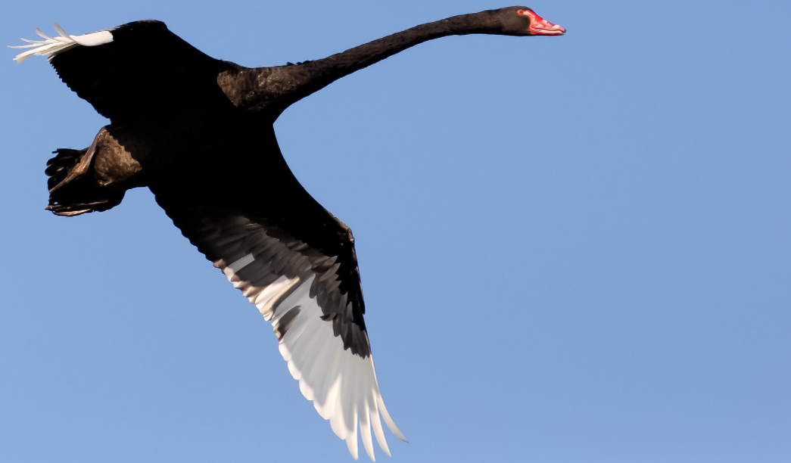
Vague concepts processing in a complex open environment
is one of the main barriers to developing advanced applications of computer science
Examples of the most popular AI/ML/Data Science solutions
How can we improve the performance of AI/ML solutions,
building a competitive business advantage to make more money?
Analysis of sentiment and emotions
Recommendation systems
Personalization systems
Anomaly and fraud detection
Customer behavior segmentation
Predicting customer churn
Logistics and inventory optimization
Tracking competition behavior (including prices)
Shopping cart optimization
Forecasting models
Optimizing and increasing the attractiveness of the website
Image, video and speech recognition
Extracting knowledge from the text
Risk management
Internet search engines
Marketing and targeted advertising
Discovering organizational processes and robotic process automation
Healthcare & Pharmacy
Autonomous control systems
It depends!
YES
Does the solution require processing vague concepts in a complex open environment?

Slide 21
Vague concepts processing in a complex open environment
is one of the main barriers to developing advanced applications of computer science
Examples of the most popular AI/ML/Data Science solutions
How can we improve the performance of AI/ML solutions,
building a competitive business advantage to make more money?
Analysis of sentiment and emotions
Recommendation systems
Personalization systems
Anomaly and fraud detection
Customer behavior segmentation
Predicting customer churn
Logistics and inventory optimization
Tracking competition behavior (including prices)
Shopping cart optimization
Forecasting models
Optimizing and increasing the attractiveness of the website
Image, video and speech recognition
Extracting knowledge from the text
Risk management
Internet search engines
Marketing and targeted advertising
Discovering organizational processes and robotic process automation
Healthcare & Pharmacy
Autonomous control systems
It depends!
Overall, today’s
AI / ML / Data Science technology
doesn't provide solutions
with satisfactory performance, and we don't see widely acceptable possibilities of a satisfactory development
of such technology
YES
Does the solution require processing vague concepts in a complex open environment?

Slide 22
Vague concepts processing in a complex open environment
is one of the main barriers to developing advanced applications of computer science
Examples of the most popular AI/ML/Data Science solutions
How can we improve the performance of AI/ML solutions,
building a competitive business advantage to make more money?
Analysis of sentiment and emotions
Recommendation systems
Personalization systems
Anomaly and fraud detection
Customer behavior segmentation
Predicting customer churn
Logistics and inventory optimization
Tracking competition behavior (including prices)
Shopping cart optimization
Forecasting models
Optimizing and increasing the attractiveness of the website
Image, video and speech recognition
Extracting knowledge from the text
Risk management
Internet search engines
Marketing and targeted advertising
Discovering organizational processes and robotic process automation
Healthcare & Pharmacy
Autonomous control systems
It depends!
Overall, today’s
AI / ML / Data Science technology
doesn't provide solutions
with satisfactory performance, and we don't see widely acceptable possibilities of a satisfactory development
of such technology
We have a lot of space to build a competitive business advantage
YES
Does the solution require processing vague concepts in a complex open environment?

Slide 23
Vague concepts processing in a complex open environment
is one of the main barriers to developing advanced applications of computer science
Examples of the most popular AI/ML/Data Science solutions
How can we improve the performance of AI/ML solutions,
building a competitive business advantage to make more money?
Analysis of sentiment and emotions
Recommendation systems
Personalization systems
Anomaly and fraud detection
Customer behavior segmentation
Predicting customer churn
Logistics and inventory optimization
Tracking competition behavior (including prices)
Shopping cart optimization
Forecasting models
Optimizing and increasing the attractiveness of the website
Image, video and speech recognition
Extracting knowledge from the text
Risk management
Internet search engines
Marketing and targeted advertising
Discovering organizational processes and robotic process automation
Healthcare & Pharmacy
Autonomous control systems
It depends!
Overall, today’s
AI / ML / Data Science technology
doesn't provide solutions
with satisfactory performance, and we don't see widely acceptable possibilities of a satisfactory development
of such technology
We have a lot of space to build a competitive business advantage
YES
Does the solution require processing vague concepts in a complex open environment?
In order to achieve significant progress in this area, it is very important to conduct basic research on the correct computational model of "computational blocks" necessary to learn (i.e., computational models different from the currently commonly used classical approach), the reasoning regarding the computation in such a model and mechanisms collaborative community of intelligent agents that use these models.

Slide 24

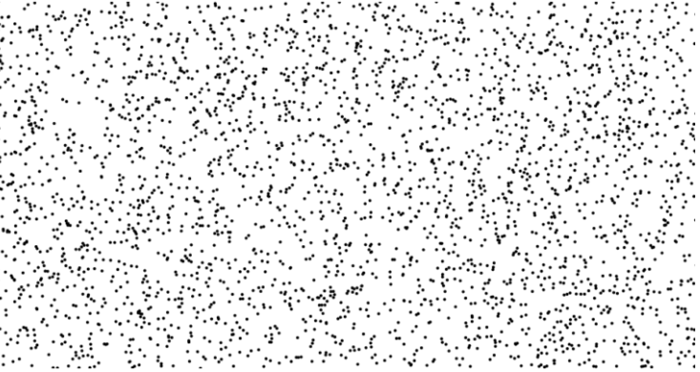
Examples of vague concepts processing in a complex open environment
Witas project
How can computers perceive and deal with the vague concept of
dangerous traffic situation
and deal with the considerable uncertainty surrounding it?

Slide 25
Examples of vague concepts processing in a complex open environment
Witas project
How can computers perceive and deal with the vague concept of
dangerous traffic situation
and deal with the considerable uncertainty surrounding it?

Slide 26
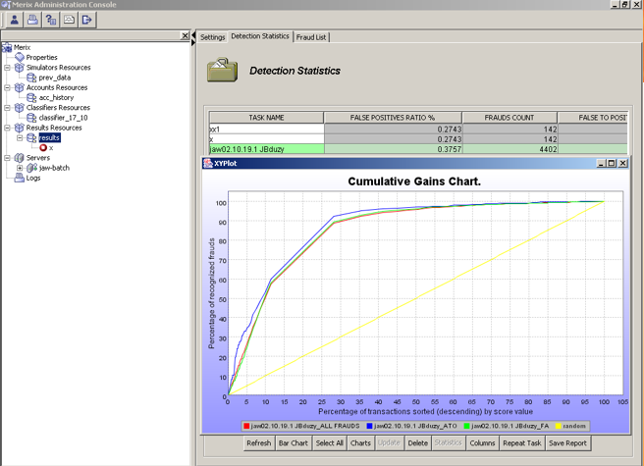
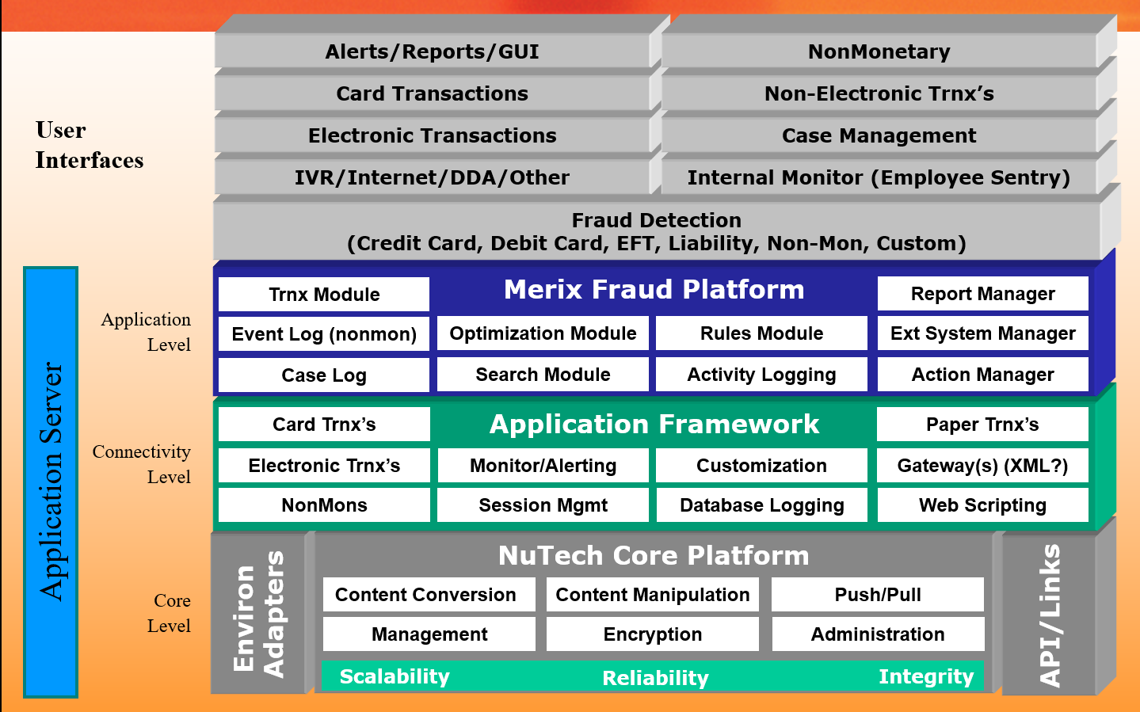
Examples of vague concepts processing in a complex open environment
Merix project
How can computers perceive and deal with the vague concept of
credit card fraud
and deal with the considerable uncertainty surrounding it?

Slide 27
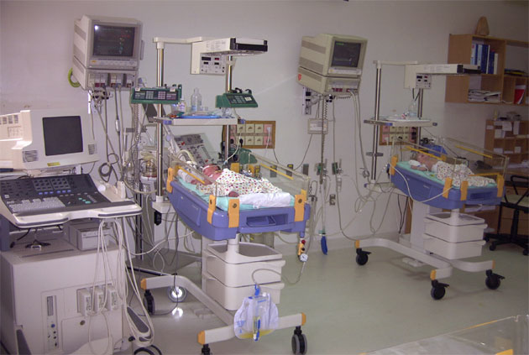
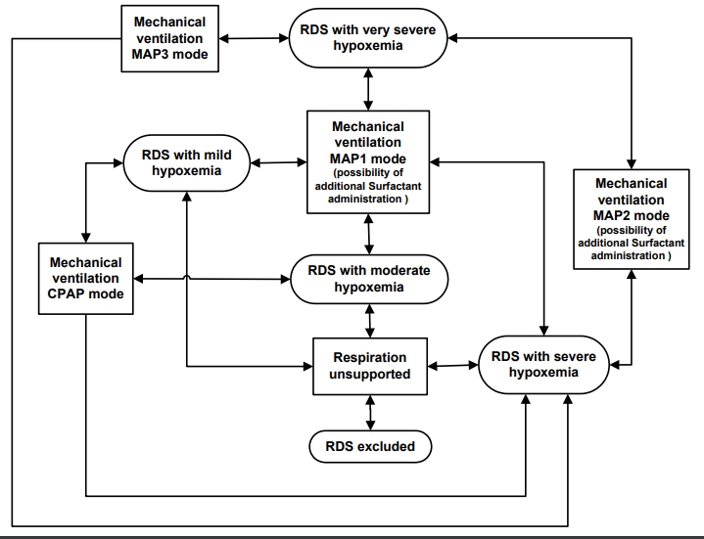
Examples of vague concepts processing in a complex open environment
RoughIce project
How can computers perceive and deal with the vague concept of
risk of losing life
and deal with the considerable uncertainty surrounding it?

Slide 28
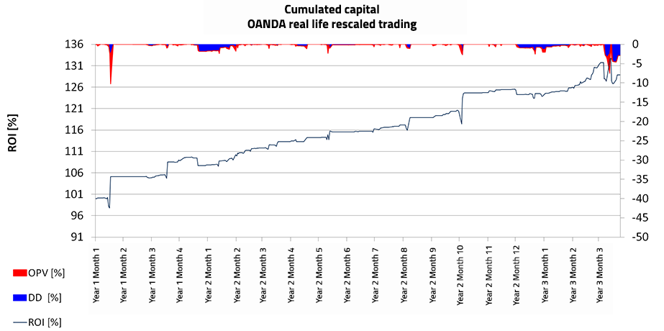
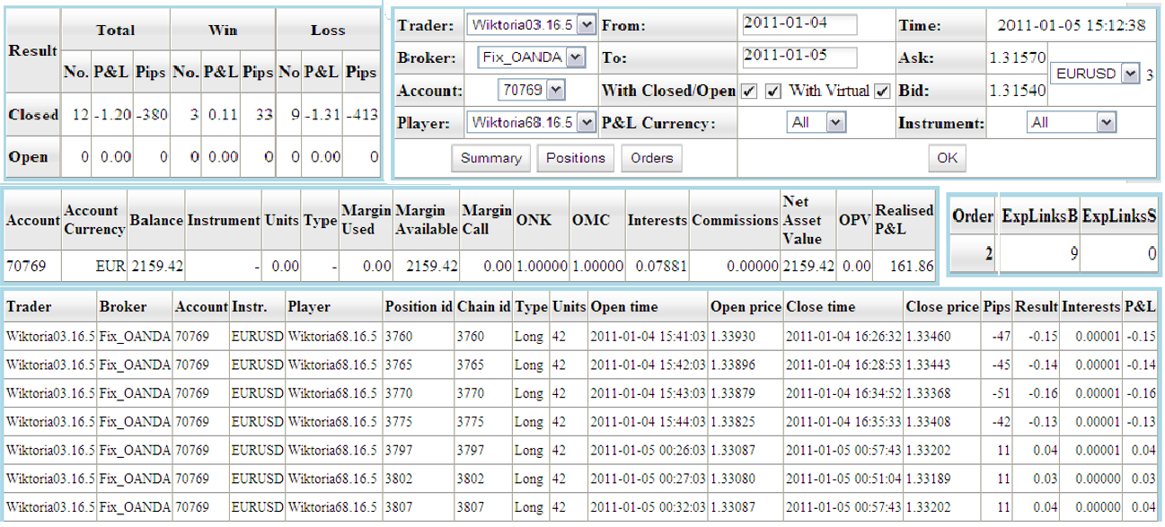
Examples of vague concepts processing in a complex open environment
AlgoTradix project
How can computers perceive and deal with the vague concept of
algo trading risk
and deal with the considerable uncertainty surrounding it?

Slide 29
Tentative syllabus for the semester
An introduction to applications of computer science in medicine and industry
Vague concepts processing in a complex open environment is one of the main barriers to developing advanced applications of computer science
Computational models for vague concepts processing in a complex in open environment (rough sets, fuzzy sets, and granular computing)
Introduction to rough sets (approximations of concepts, decision systems, reducts, decision rules, discretization) and development of approximate classifiers.
Design and development of classifiers (simple and hierarchical) using rough sets.
Basics of fuzzy sets and their application to constructing decision systems and process control systems.
Concept of granular computing
Constructions of explainable classifiers using linear and logistic regression, decision trees, random forests, and SVM
Classifiers development for imbalanced data
An introduction to optimization algorithms in IT applications in medicine and industry

Slide 30
Computer Science in Medicine and Industry
An Introduction
Lecture 1
Dr hab. Andrzej Jankowski, professor UWM
5/X//2022

